Slide 1
YouTube Data Analysis Based on Titles using NLP
Institute for Advanced Computing and Software Development (IACSD), Pune
Group No. - 1
Dhavale Alisha Satish 243513
Sharvary Snehadeep Hedau 243548

Slide 2
Objectives
Analyze YouTube video titles to gain insights using Big Data techniques.
Identify trends in YouTube video titles to understand popular content.
Develop strategies to optimize video titles for better engagement.

Slide 3
Data Collection
Source: Data was generated using the Faker library
Number of records : 150000
No. of features : 7
Key features: video_id, title, views, likes, dislikes, comment_count, publish_date

Slide 4
Data Preprocessing
Cleaning Data: Removing duplicates, null values, irrelevant features.
Text Processing: Tokenization, stemming, removing stop words from titles.
Tools: PySpark’s data processing capabilities.

Slide 5
Exploratory Data Analysis (EDA)
Initial Insights: Trends in title length, word frequency.
Library : sklearn , nltk
Visualization Tools: Matplotlib, Seaborn for visualizing title attributes.

Slide 6
Title Length Analysis
Analysis: Distribution of title lengths.
Insights: Correlation between title length and views/engagement.

Slide 7
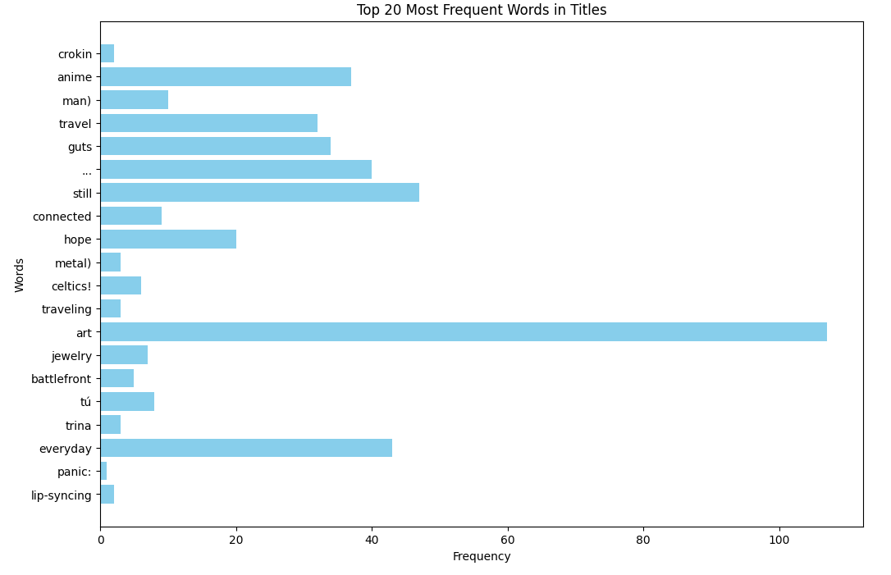
Top 20 Most Frequent Words In Titles

Slide 8
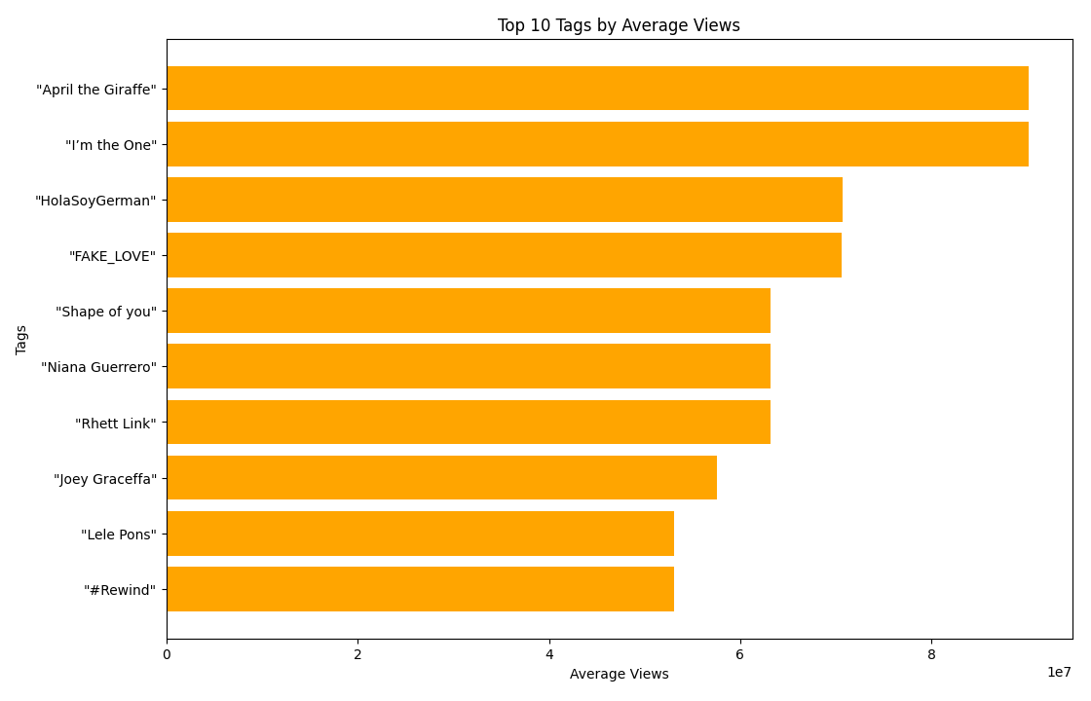
Top 10 Tags by Average Views

Slide 9
Word Frequency Analysis
Word Cloud: Most common words used in video titles.
Analysis: Insights into popular content topics.

Slide 10
Sentiment Analysis
Sentiment Analysis: Approach used to classify title sentiment.
Tools: PySpark MLlib, Natural Language Processing techniques.
Findings: Trends in positive, negative, or neutral titles.

Slide 11
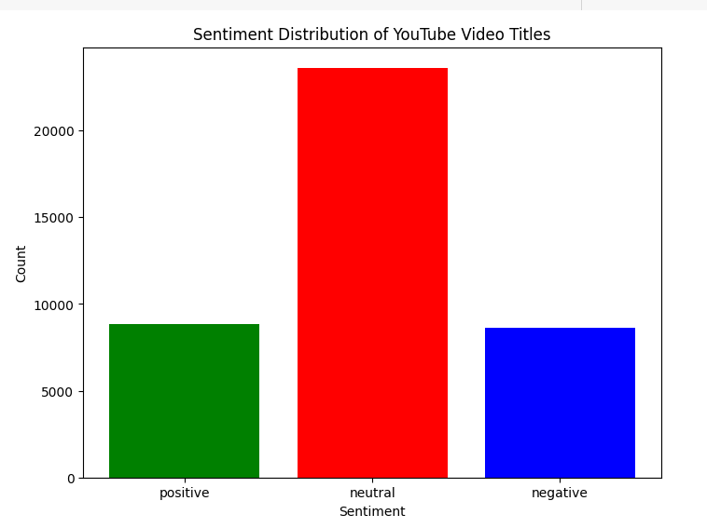

Slide 12
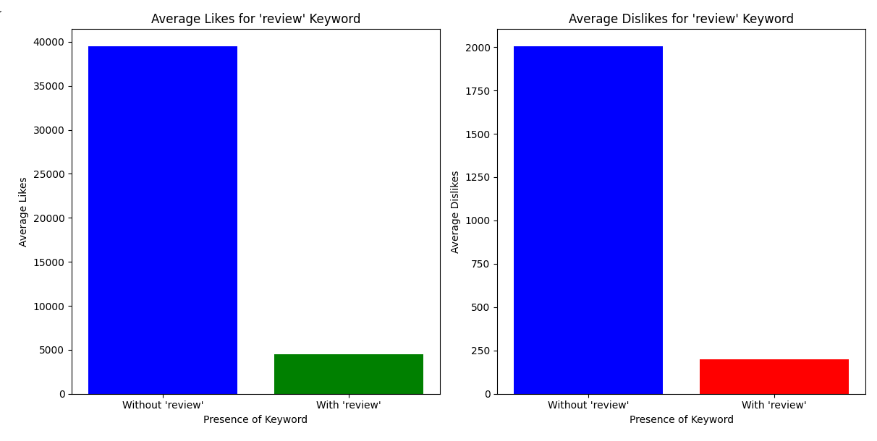
Average Likes /Dislike for Review Keyword

Slide 13
Title and Engagement Correlation
Analysis: Relationship between title keywords and video engagement (likes, views).
Insights: Effective keywords for better engagement.

Slide 14
Big Data Challenges
Challenges Faced: Handling large datasets, processing speed,
memory management.
Solutions: How PySpark helped in overcoming these challenges.

Slide 15
Future Work
Potential for expanding analysis to other YouTube features (comments, descriptions).
Compare findings with actual YouTube data for validation and deeper insights.

Slide 16
Thank You!

